Slide 1
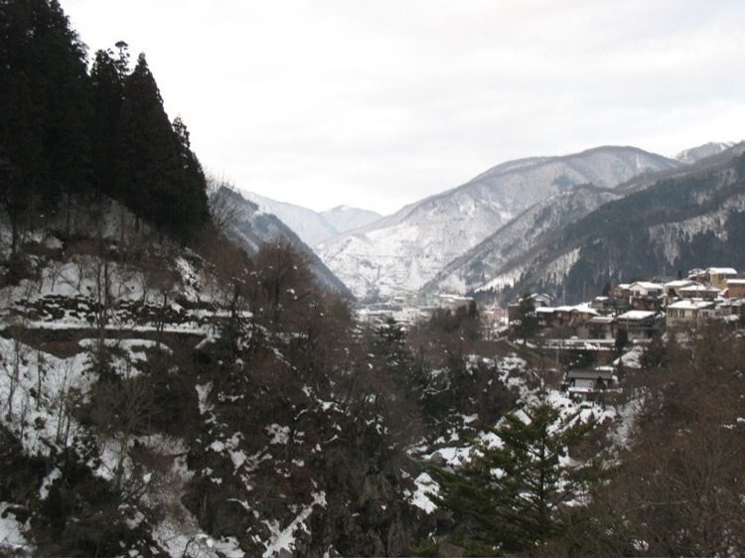
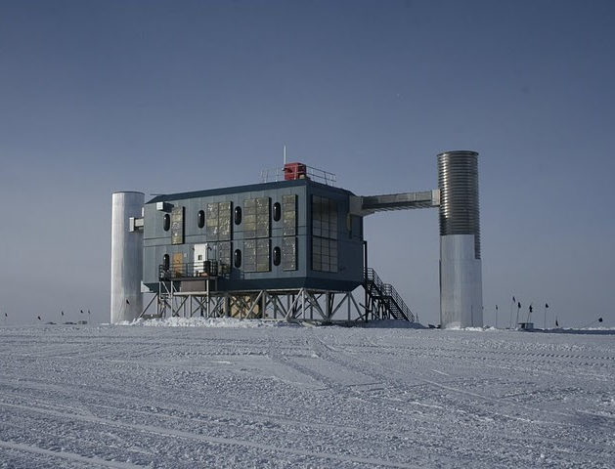

Super-Kamiokande and IceCube
- two complementary approaches to neutrino astronomy
..thanks to many for providing slides (knowingly or not …)
Kamioka Mountain
IceCube Counting House
Lutz Köpke
Johannes Gutenberg University Mainz
CCAPP, Columbus, Ohio, April, 4, 2011

Slide 2
Outline
Introduction, detector principles and sensitivities
Neutrino oscillation physics
High energy neutrino astronomy
Core collapse supernovae
Main objectives of Super-Kamiokande and IceCube:
Determine properties, interactions and „QM“ of neutrinos
Test extensions of our standard field theory
  → larger symmetry groups (e.g. „Proton Decay“)
  → additional symmetries (e.g. „Super-Symmetry)
  → symmetry violations (CPT, Lorentz etc. )
Discover origin of cosmic rays and nature of cosmic catalcysms

Slide 3
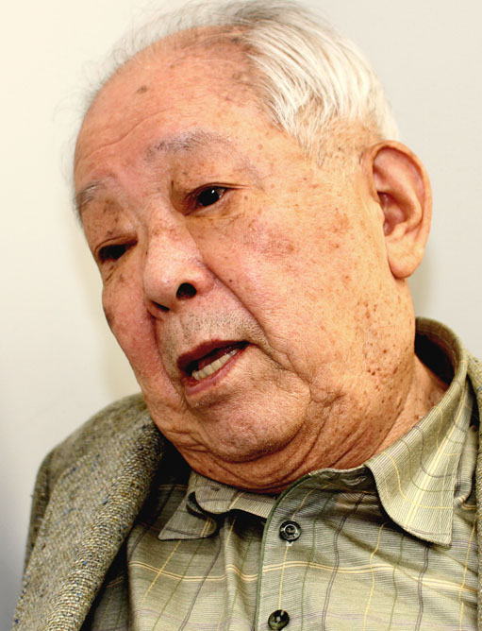
1. Introduction and detectors
Moisei Alexandrovich Markov
Masatoshi Koshiba
Nobel Prize 2002
„Grandfathers of ν astronomy“
Mid 1950‘s: proposal for deep
underground and underwater
neutrino observatories
“A professor denounced me as being no good at physics. That made me furious. So I took the entrance exam for the physics department.”
Notes:
Markov warned the soviet leaders in 1947 about „dangerous political-ideological moves that threaten to separate soviet science from thre rest“
This was a brave (almost suicidal) move, as he and other scientists were charged of not sufficiently quoting Russian scientists and
„uncritically receiving western physical theories and propagandizing them in our country“
Stalin, however, „chose the atomic bomb over ideology“ → which saved their lives …
Later, Markov became active in promoting disarmament

Slide 4
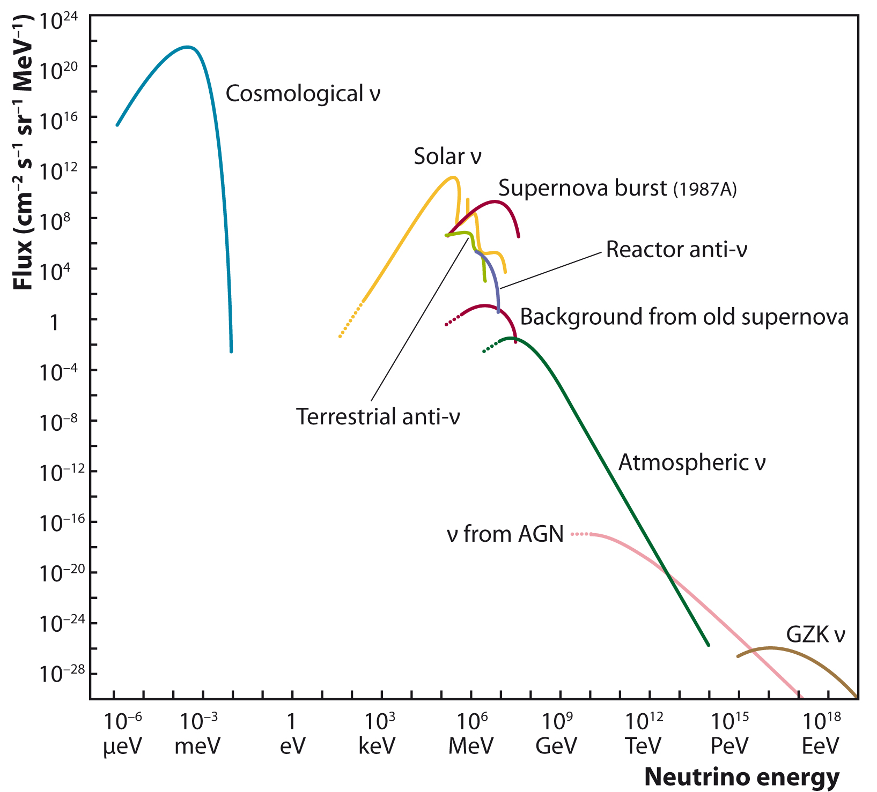
Fluxes of cosmic neutrinos
under-
ground
optical:
- deep water
- deep ice
air showers
radio
acoustics
Kamiokande also uses neutrinos from accelerator beams (e.g. T2K)

Slide 5
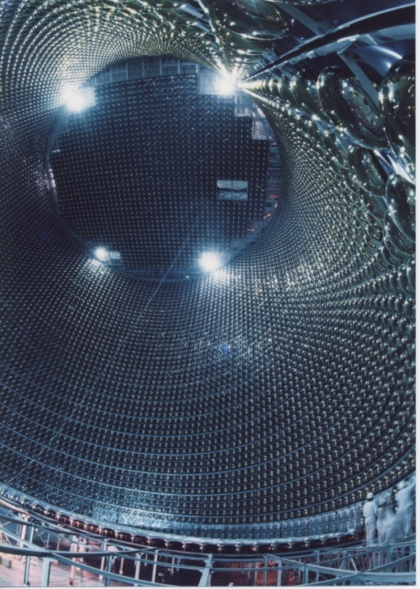
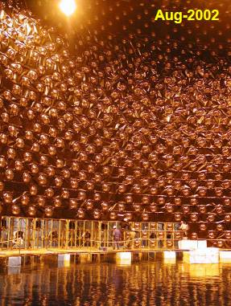
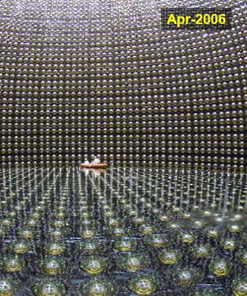
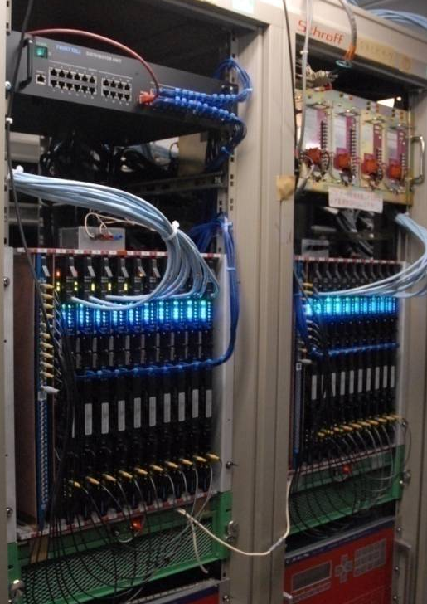
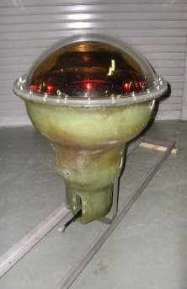
Super-Kamiokande
120 collaborators, 31 institutions, 6 countries
Will provide data for
a long time (…2025)!
supernovae, proton decay …
1996 | 1997 | 1998 | 1999 | 2000 | 2001 | 2002 | 2003 | 2004 | 2005 | 2006 | 2007 | 2008 | 2009 | 2010
SK-I
Acrylic (front)
+ FRP (back)
SK-II
SK-III
SK-IV
11146 PMTs
(40% coverage)
5.0 MeV
5182 PMTs
(19% coverage)
7 MeV
11129 PMTs
(40% coverage)
5 MeV
Electronics
Upgrade
~4.5 MeV < 4.0 MeV
achieved goal
Total energy threshold

Slide 6
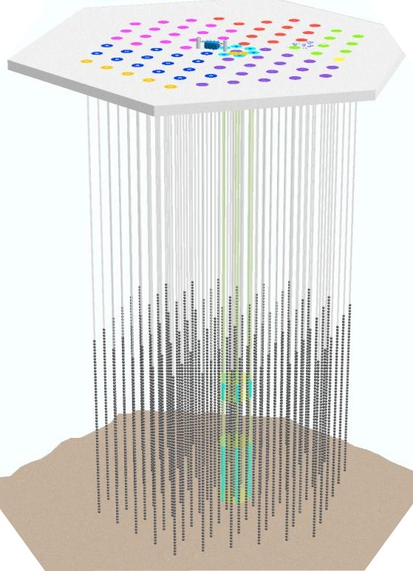
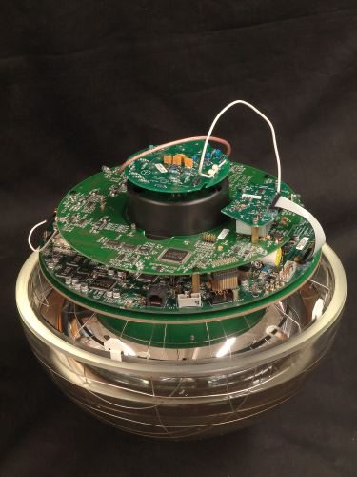
The IceCube Observatory
250 collaborators, 36 institutions, 9 countries
1000 m
80 sparsely instrumented strings
⇨ 17 m vertical sensor distance
⇨ 125 m horizontal string distance
6 densely instrumented strings (“DeepCore”)
⇨7-10 m sensor distance
⇨ 60 m horizontal string distance
5160 sensors + autonomous DAQ in ice
1450 m
1000 m
December 2010: IceCube fully deployed !!!

Slide 7
IceCube accumulated exposure
… for 100 TeV
data available
Factor 300 since 2000
The interesting time is now !

Slide 8
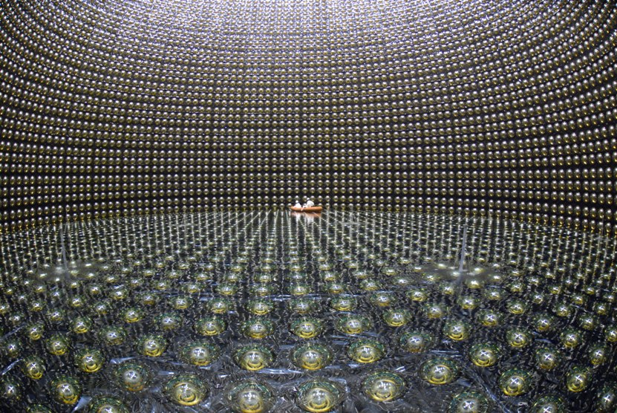
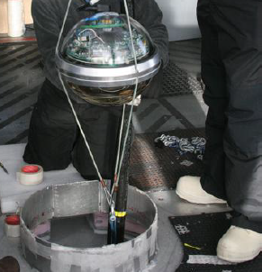
Complementary approaches
~125 m
~17 m
Imaging detector:
→ 40% PMT coverage
„precision detector“:
→ Calibration uncertainties O(%)
Sparse sampling detector
→ < 1% PMT coverage
„discovery instrument“:
→ Systematic uncertainties O(10-20%)
Both detect all neutrino species (ν_{μ} ν_{e} ν_{τ} ) ,
but are optimized for very different energy ranges and neutrino fluxes …

Slide 9
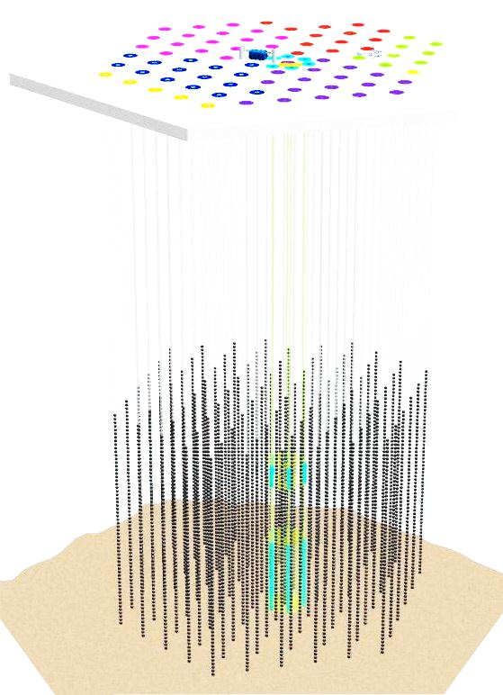
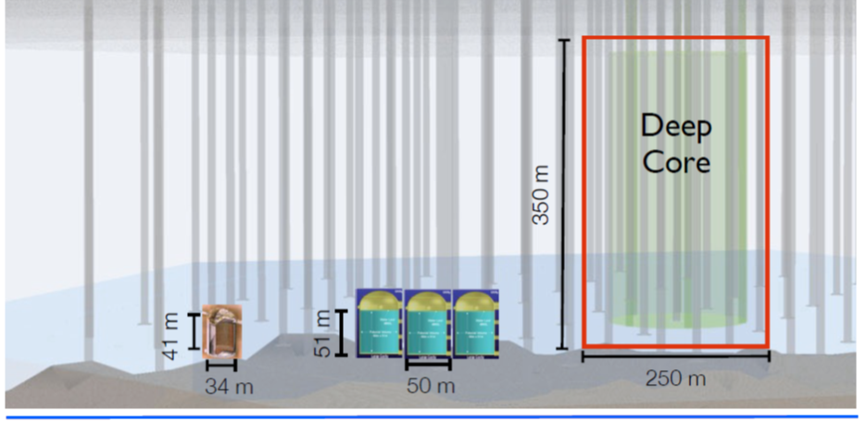
Size comparison and energy coverage
IceCube: 1000 Mton
DeepCore: 15 Mton
Super-K: 0.05 Mton
1 MeV 10 MeV 100 MeV 1 GeV 10 GeV 100 GeV 1 TeV 10 TeV 100 TeV
IceCube
DeepCore extension
Super-K
solar ν
SN ν
proton decay atmospheric neutrinos (extra)galactic ν

Slide 10
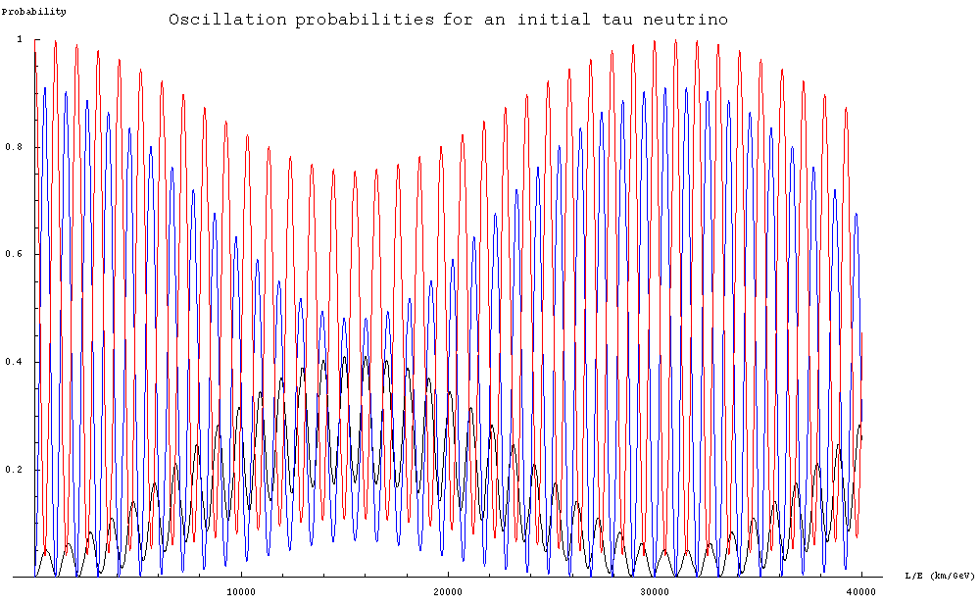
II. Neutrino Oscillations
Schematically: ν_{τ} ν_{μ}
ν_{e}
frequency:
m_{i}²-m_{j}² ∝ E / L
ν_{τ}
mixing angles:
θ₁₂,θ₂₃,θ₁₃
0.2 0.4 0.6 0.8 1.0
ν_{μ}
probability
ν_{e}
10000 20000 30000 40000 km/GeV

Slide 11

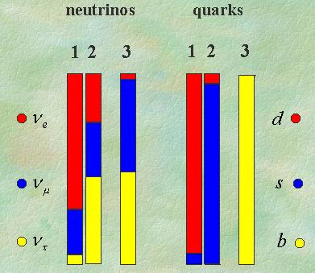
Neutrinos
propagating mass eigenstate ≠ weak interactions eigenstates
unknown CP violation
only limit θ₁₃< 10º known
would like improved precision
… at the end one would like to understand
why neutrinos mix differently than quarks
Present knowledge (Lisl, Neutel2011):
θ₁₂ = (33.6^{+1.2}_{-1.0})º (~ 3%)
θ₂₃ = (40.4^{+5.2}_{-3.5})º (~ 11%)
θ₁₃ < 13º
m₂²-m₁² = (7.54^{+0.25}_{-0.21}) x 10⁻⁵ [eV²] (~ 3%)
m₃²-m₂² = (2.36^{+0.12}_{-0.10}) x 10⁻³ [eV²] (~ 5%)

Slide 12
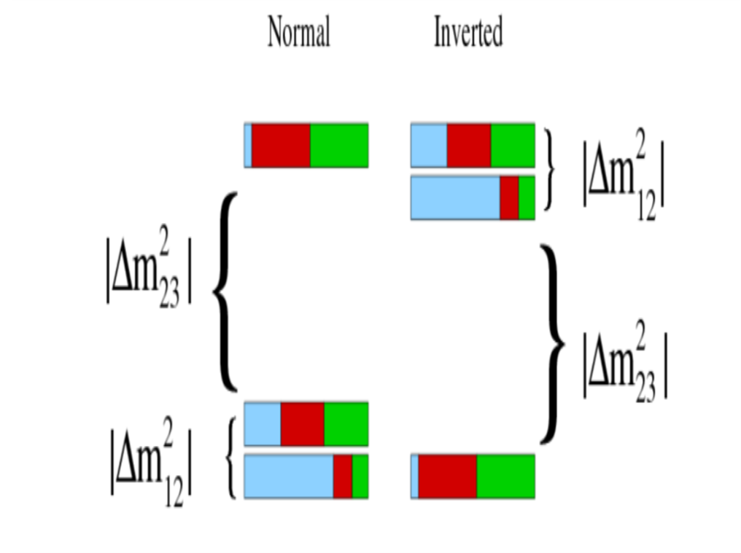
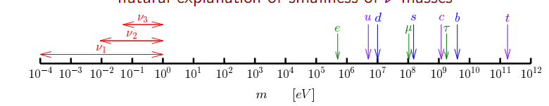
More specific questions …
… that can be answered in neutrino oscillation experiments
Can we see appearance of ν_{τ}? (→ Opera)
How large is θ₁₃?
Is there CP-violation in the neutrino sector?
What is the neutrino hierarchy?
normal inverted

Slide 13
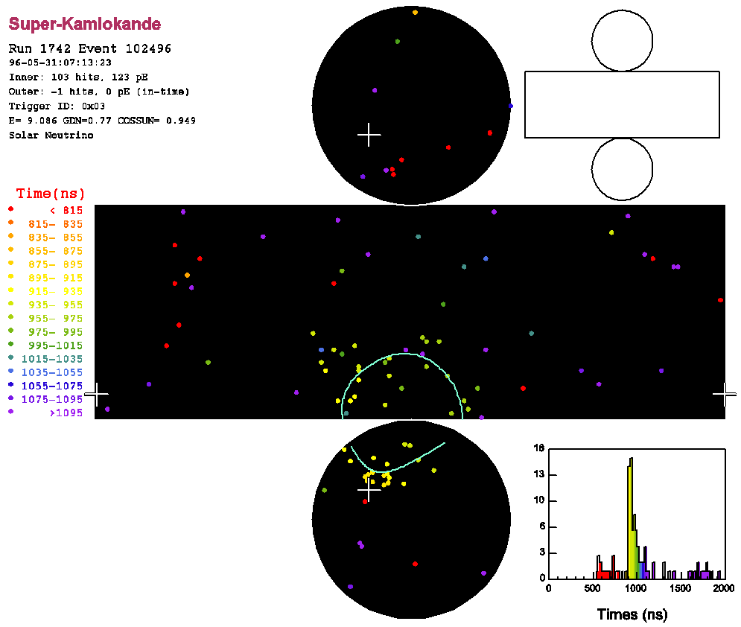
Low-energy solar ν + e⁻ → ν + e⁻ candidate
~ 6 hits / MeV
(SK-I, III, IV)
Timing information:
→ vertex position
Ring pattern:
→ direction
Number of hit PMTs:
→ energy
color: time
E_{e} = 9.1MeV
cosθ_{sun} = 0.95
SK-IV up to Nov. 2010
SK-III resolution 10 MeV electrons: vertex: 55 cm
direction: 23º
energy: 14%

Slide 14
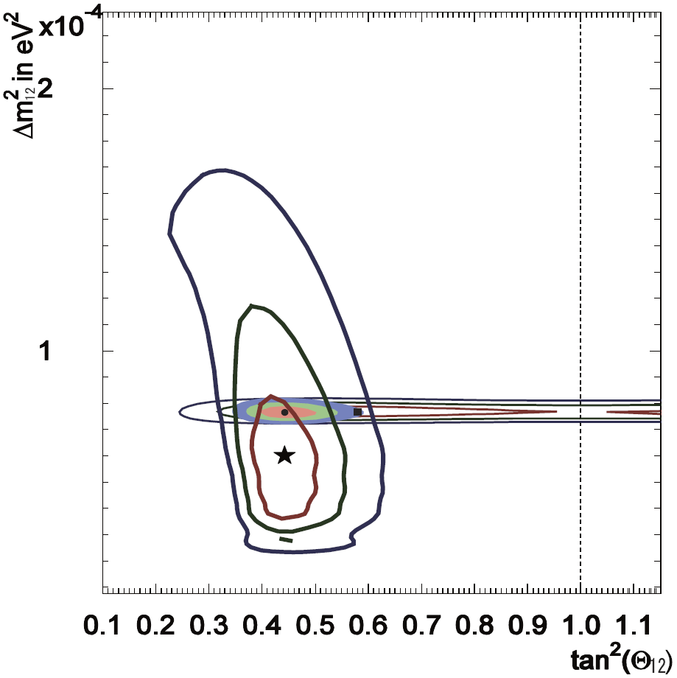
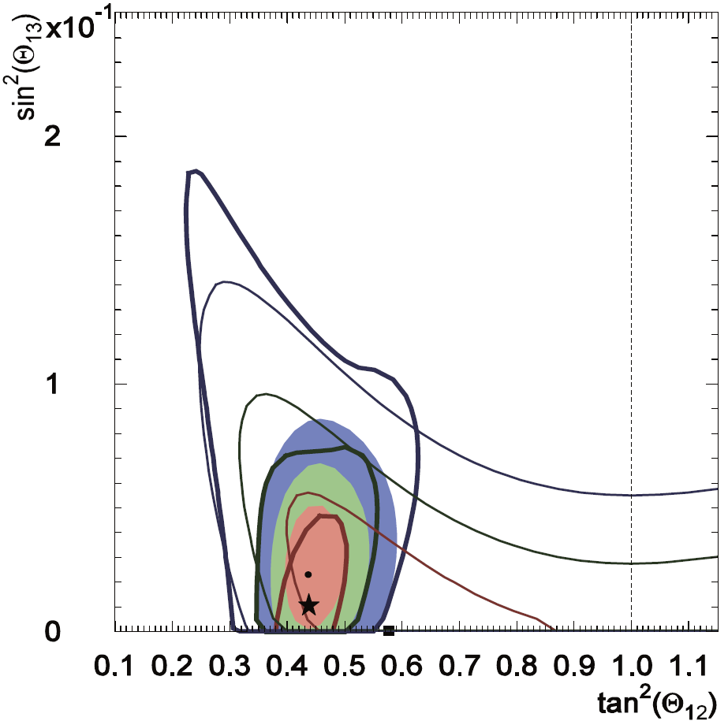
Three-Flavor Analysis (including SK-I+II+III)
arXiv:1010.0118
68, 95, 99.7% C.L.
sin²θ₁₃
Solar global
KamLAND
Solar+KamLAND
Δm²₁₂ [eV²]
Solar ν-results
Preliminary
KamLAND
tan²θ₁₂
tan²θ₁₂
θ₁₃ = 9.1^{+2.9}_{-4.7}º ( < 14º at 95%C.L.), but consistent with 0 !

Slide 15
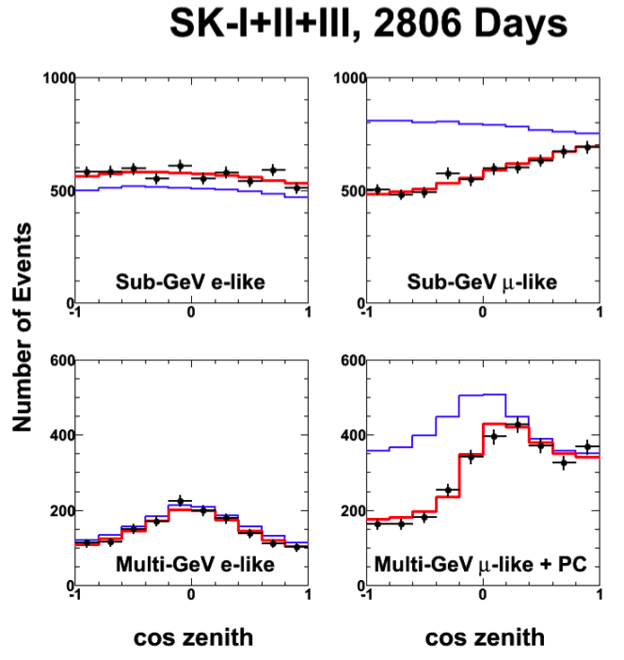
Zenith angle distributions atmospheric ν’s
Super-Kamiokande I+II+III, 2806 days
ν_{μ}–ν_{τ} oscillation (fit)
no oscillation
Clear μ deficit !
No e deficit !
→ determine θ₂₃
Δm²₂₃
→ limit θ₁₃, δ
→ observe ν_{τ} ?
e-like
μ-like

Slide 16
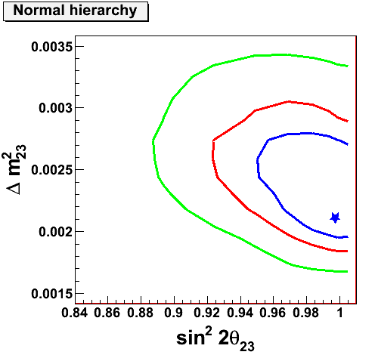
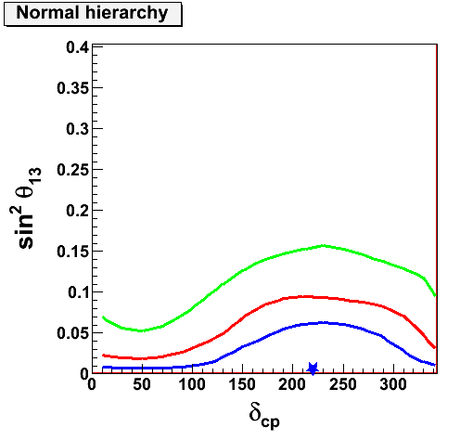
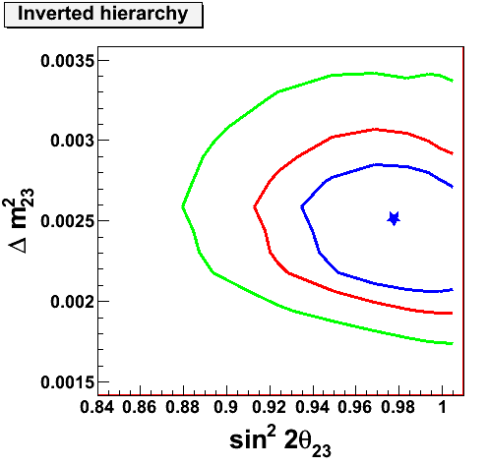
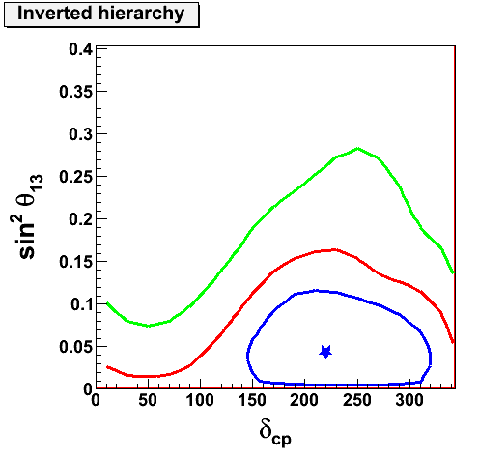
Full 3-flavor oscillation results
3.5x10⁻³
0.4
Normal hierarchy
SK-I+II+III
Minos 90%CL
99% C.L.
90% C.L.
68% C.L.
best fit
Super-K preliminary
1.5x10-³
0
0
300
3.5x10⁻³
0.4
Inverted hierarchy
No significant hierarchy difference
or constraint on CP δ
at 90% CL !
1.5x10⁻³
0
0.84
1
0
300

Slide 17
Full 3-flavor oscillation results (SK I-III)
Normal hierarchy
3.5x10⁻³
0.4
99% C.L.
90% C.L.
68% C.L.
best fit
Minos 90%CL
Super-K preliminary
1.5x10-³
0
0
300
… similar, but less constraint for inverse hierarchy
No significant hierarchy difference or constraint on CP δ at 90% CL !

Slide 18
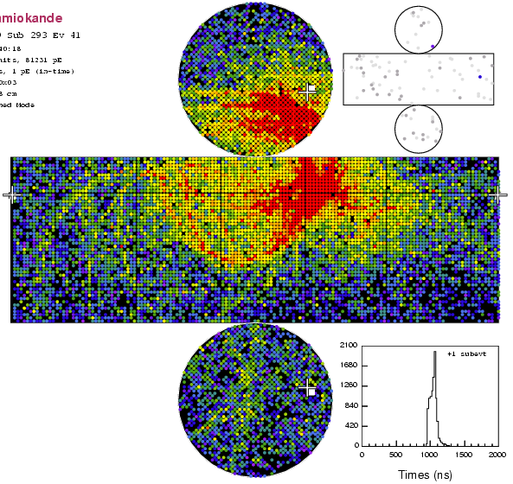
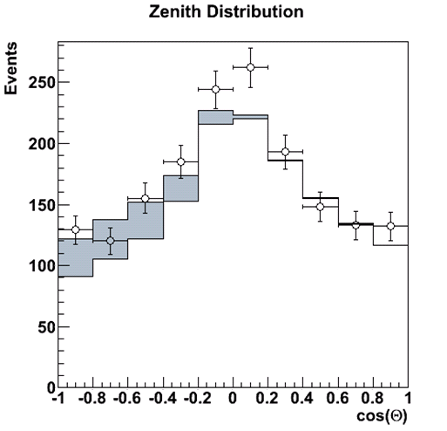
ν_{τ} events at Super-K
Negligible primary flux
→ Any observed τ oscillation induced !
→ but: complicated event topology
GOAL : test the null hypothesis of
“no τ appearance”
ν_{μ} ν_{τ} τ
e or μ or hadrons
Energy threshold:
3.5 GeV
Fitted
τ excess
inconsistent with no
τ appearance at 3.8σ

Slide 19
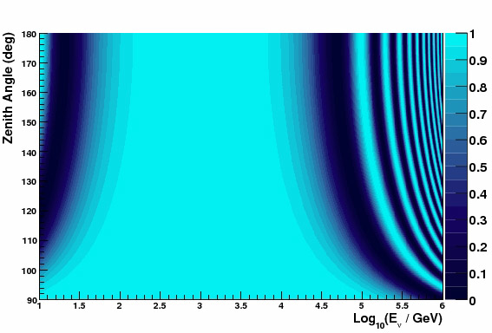
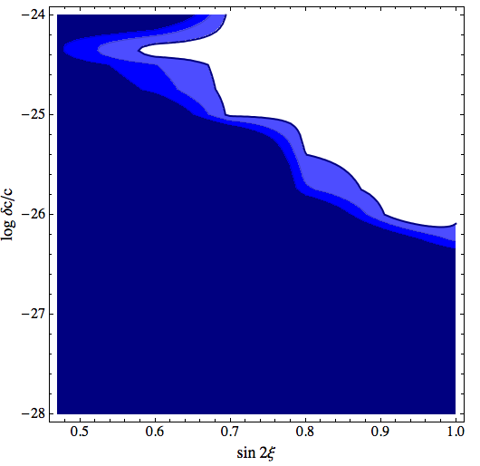
Exotic Oscillations (IceCube)
Quantum gravity effects: Lorentz invariance violation and quantum decoherence
standard oscillations ∝ 1/E
quantum gravity oscillations ∝ E (or E²)
e.g. VLI: speed of light = f(neutrino flavor):
parameters: δc/c, sin 2ξ, Phase η
Muon neutrino survival probability
excluded
VLI oscillations,
δc/c = 10⁻²⁷
-25
Log δc/c
conventional
oscillations
“DeepCore”
-27
sin 2 ξ

Slide 20
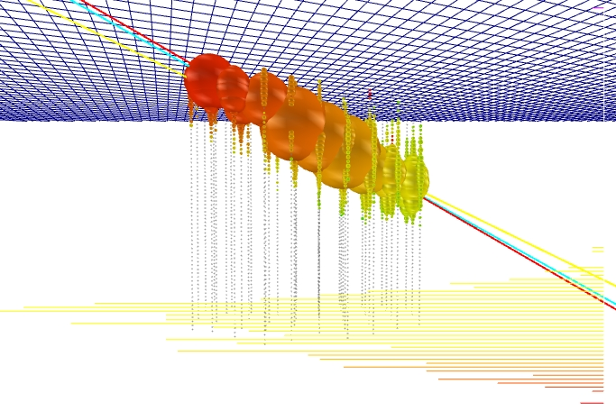
III. High energy ν astronomy
highest energy event
255000 photo-electrons!
if muon bundle: E ~ 10¹⁶ eV

Slide 21
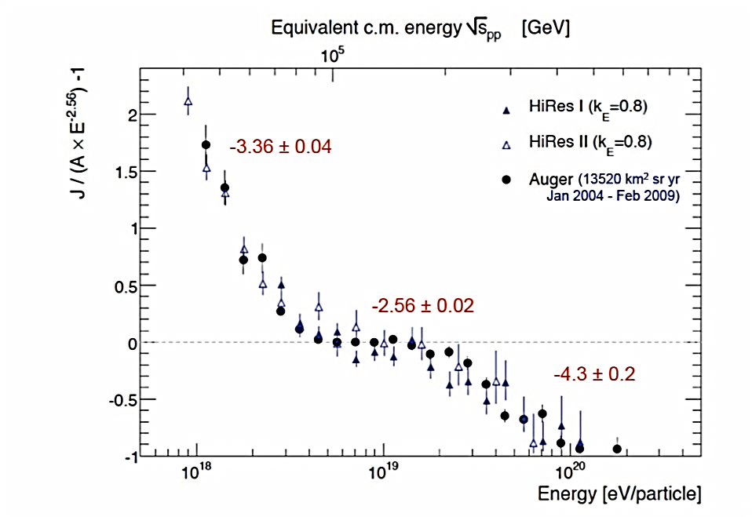
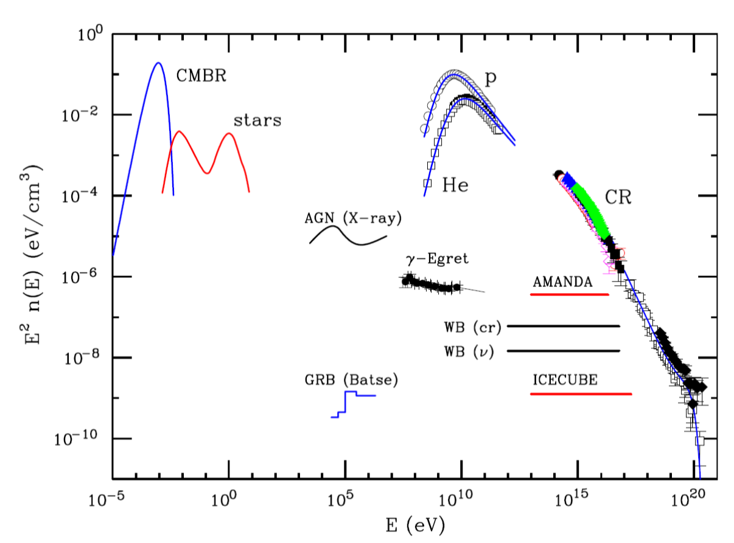
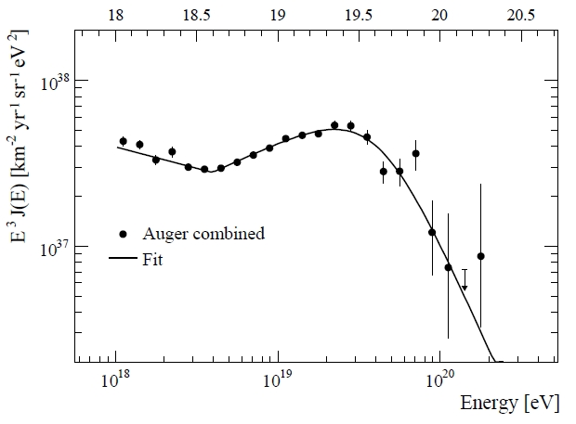
Waxman-Bahcall limit
Idea: constrain possible neutrino flux from extragalactic cosmic ray intensity
→ neutrinos must be created in „cosmic ray beam dumps“
Extragalactic flux
WB upper limit (ν)
IceCube sensitivity
Assume pγ (and pp, pn) interaction
in surrounding material
  pions and kaons → neutrinos
Assume „optically thin sources“
Extrapolate to lower energy
assuming flux ~ 1/E²
… depends on many assumptions …
WB: expect flux 1/5?
… there are also many specific models (AGN, GRB, galactic sources …)

Slide 22
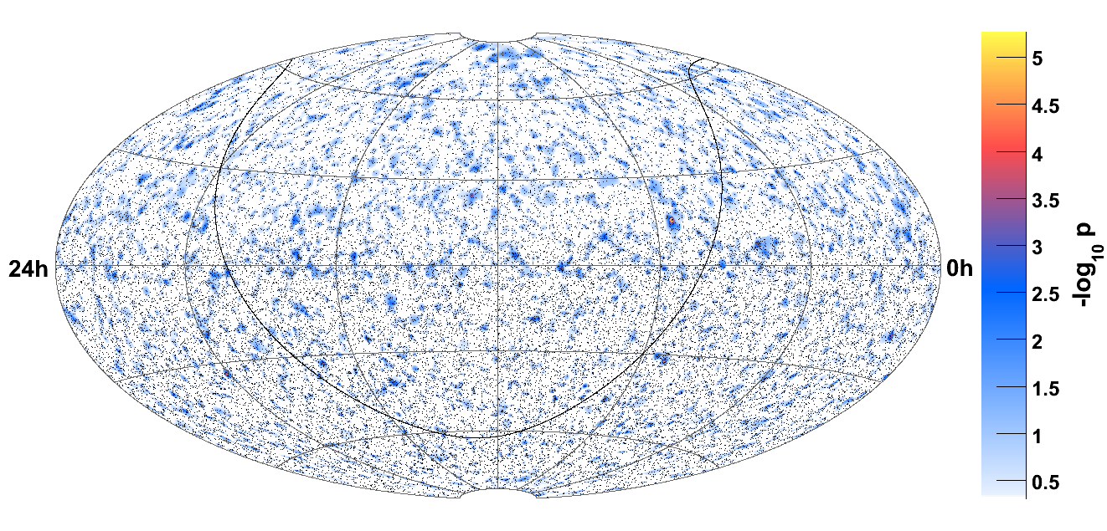
IceCube sky map (50% of detector)
Live time 375 days, 14121 upgoing events, 22779 downgoing events
„hottest spot“ – post-trial value 18%
no discovery yet !

Slide 23
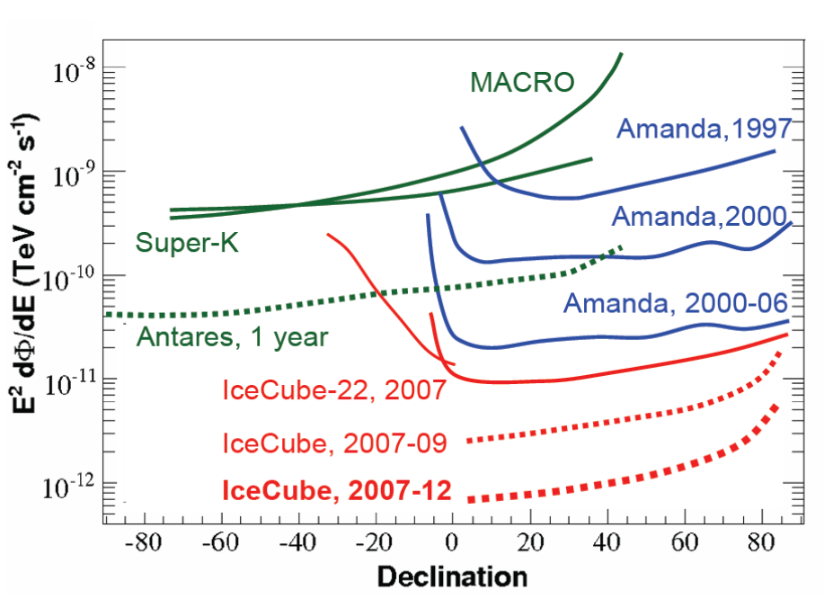
Limits for point sources with flux ∝ 1/E²
Factor
1000
in 15 years !

Slide 24
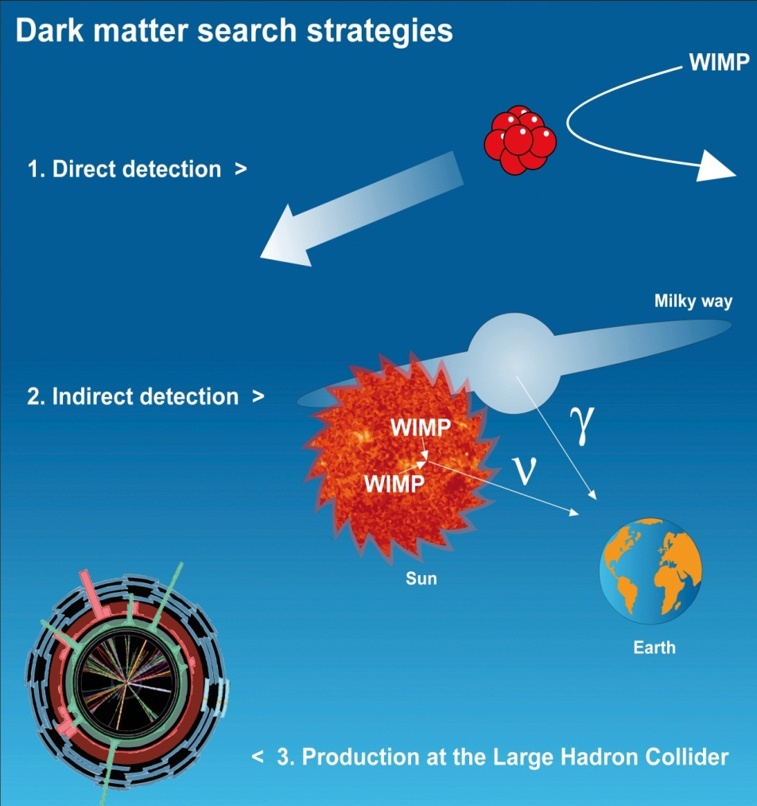
Complementarity in dark matter searches
Sensitivity direct searches
direct detection
allowed
models
spin-independent cross section
indirect detection
Sensitivity IceCube (Super-K)
spin-dependent cross section
Production at LHC collider
e.g. Cohen, Phalen, Pierce
Phys. Rev. D81, 116001 (2010)
Direct searches profit from coherent
interaction on nucleon (∝ A²)
ν telescopes profit from large detection volume

Slide 25
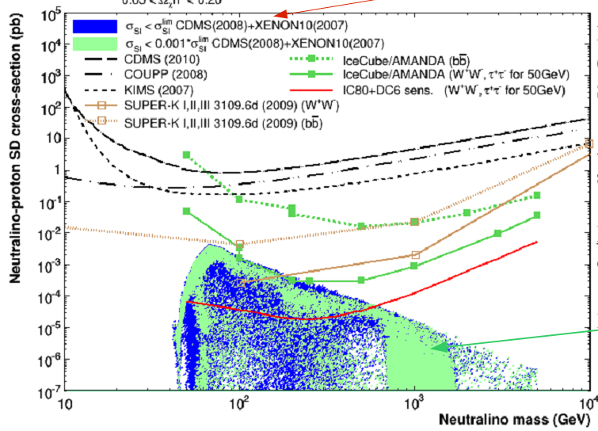
Dark matter sensitivity – spin dependent σ
IceCube: sensitivity 100 x direct search experiments (sun mostly hydrogen!)
Excluded by direct detection experiments
for spin-dependent interaction
Super-K (2009)
Prel. limit (W⁺,W⁻)
IceCube/Amanda
limit (W⁺,W⁻)
IceCube/DeepCore
sensitivity (W⁺,W⁻)
preliminary
Non-excluded even if SI- limits improved by 1000
MSSM scan

Slide 26
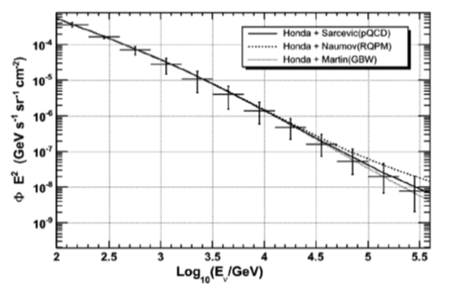
… continuing to higher energies
look for excess of ν_{μ} , ν_{e} etc on top of atmospheric neutrinos
Spectrum of atmospheric ν_{μ}
100 TeV=10¹⁴ eV
study energies above O(50) TeV

Slide 27
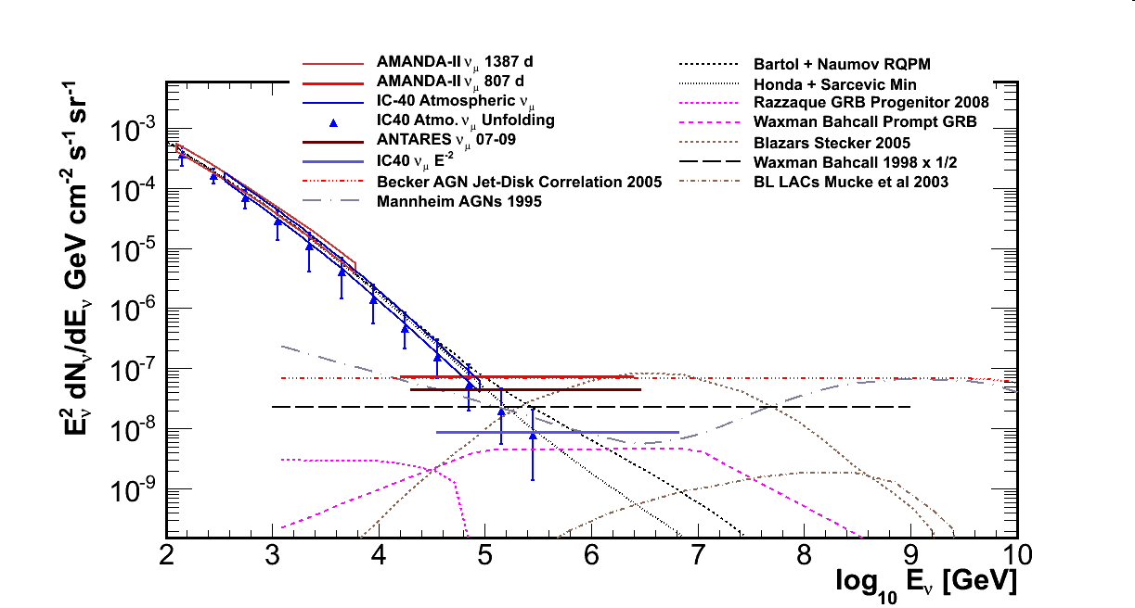
Extraterrestric ν_{μ} - diffuse flux
… the Waxman-Bahcall bound has been crossed …
IceCube 40 strings: 5σ excluded
Waxman-Bahcall bound

Slide 28
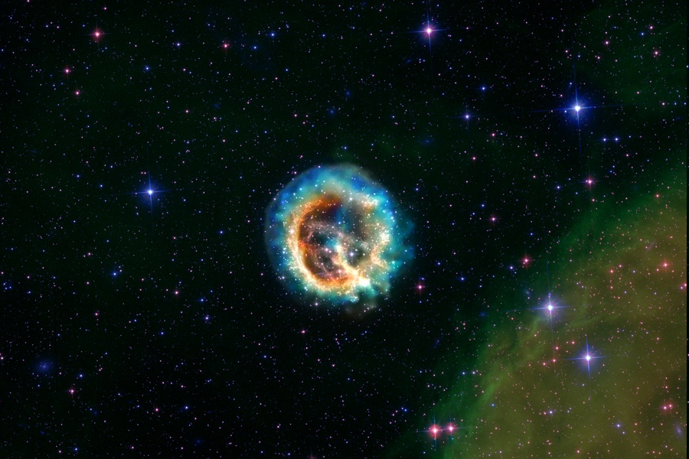
EGADS Schedule
IV. Core collapse supernova detection
2009-10: Excavation of new underground experimental hall,
construction of stainless steel test tank and
PMT-supporting structure (all completed, June 2010)
2010-11: Assembly of main water filtration system (completed),
tube prep, mounting of PMT’s, installation
of electronics and DAQ computers
2011-13: Experimental program, long-term stability assessment
Milky Way: 2 ± 1 core collapse supernovae per century
with 3 supernovae/century, probability of observation:
25 % within 10 years
45% within 20 years
Goal: get most of physics out of this precious event
Relic neutrinos … neighboring galaxies?
At the same time, material aging studies will be carried out in Japan, and
transparency and water filtration studies will continue in the US
The goal is to be able to state conclusively whether or
not gadolinium loading of Super-Kamiokande will be
safe and effective.
Target date for decision = mid-2012

Slide 29
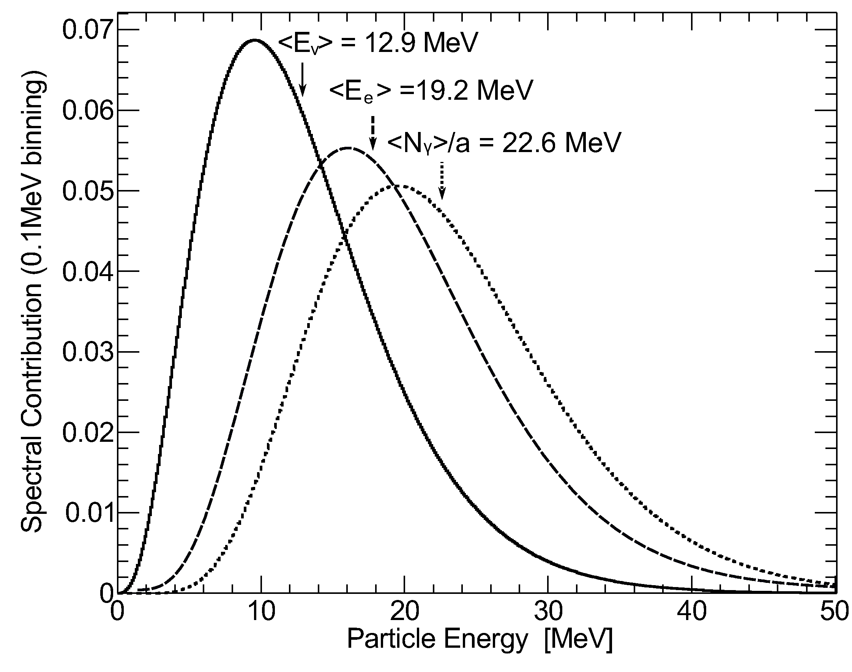
Energy release ΔE
… R=10¹⁰ m star collapses via a R_{core}=10⁶ m core to a R_{NS} =10⁴ m neutron star
ΔE_{ν} ≈ ΔE
ΔE_{kin} ≈ 10⁻² ΔE
ΔE_{em} ≈ 10⁻⁴ ΔE
individual neutrino energy ~ ΔE_{ν} /N_{ν}
dominant reaction: ν_{e}+ p → e⁺ + n
cross section: ∝ E²_{ν} (count events - SK)
Cherenkov light: ∝ E³_{ν} (count γ‘s - IceCube)
… rates strongly dependent on ν energies …
track length ~ 0.57 cm x E_{e+} (MeV)
N_{γ}^{300-600nm} ~ 180 x E_{e+} (MeV)
8.8 M progenitor O-Me-Mg core (1s after bounce)

Slide 30
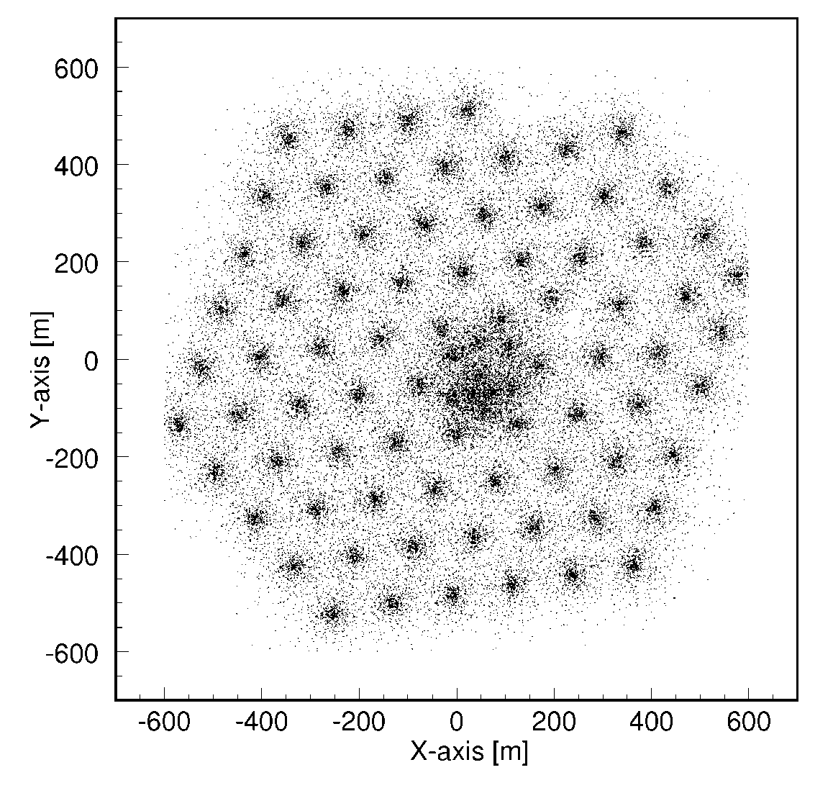
Interaction vertices in IceCube
Idea: track coherent increase of total rate due to neutrinos on top of low dark noise
view from above
Dark noise: ~ 540 Hz/DOM
can be reduced somewhat …
dominant reaction: ν_{e}+ p → e⁺ + n
cross section: ∝ E²_{ν} (events - SK)
Cherenkov light: ∝ E³_{ν} (γ‘s - IceCube)
Effective volume: ~30 m³/MeV of e⁺
Effective volume overlap small O(1%)

Slide 31
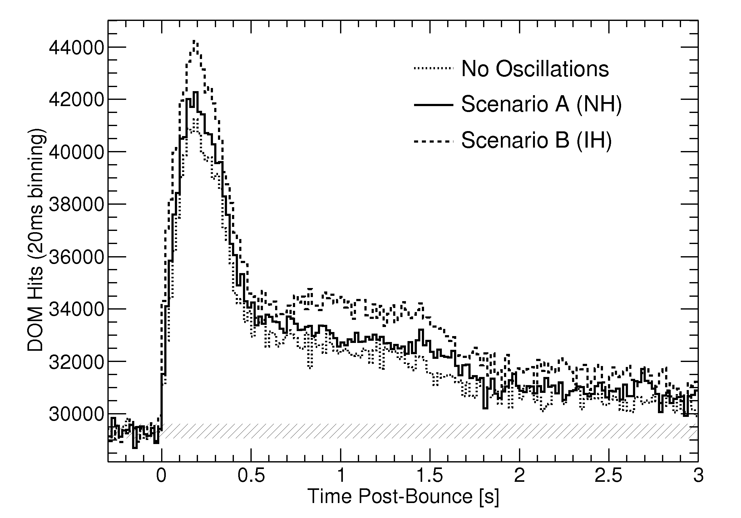
Expected rate distribution (IceCube)
Lawrence Livermore model, 10 kpc distance (~ distance to center)
IceCube Monte Carlo with time dependent energy spectra incorporated
normal neutrino hierarchy
inverted neutrino hierarchy
Totani et al.
Astrop. Phys. 496,
216 (1998)
preliminary
background
level
clear differences in model shapes for normal and inverted hierarchy!

Slide 32
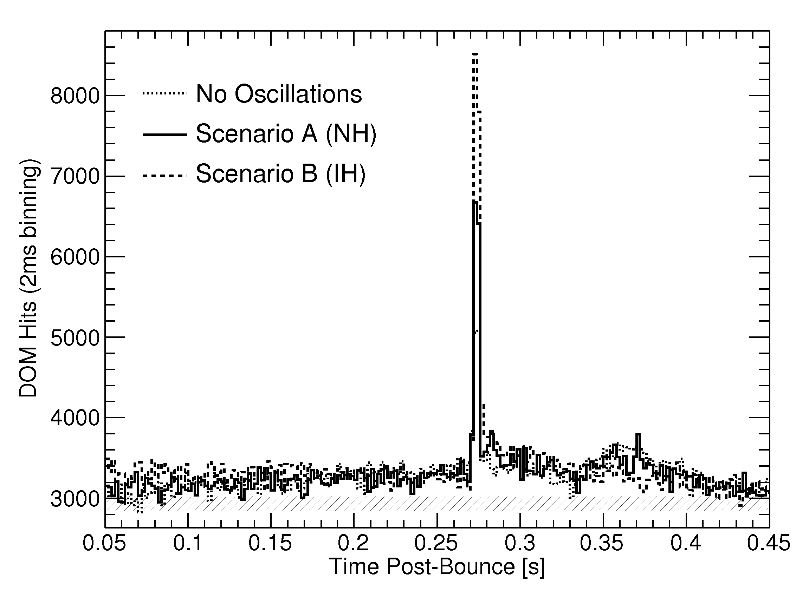
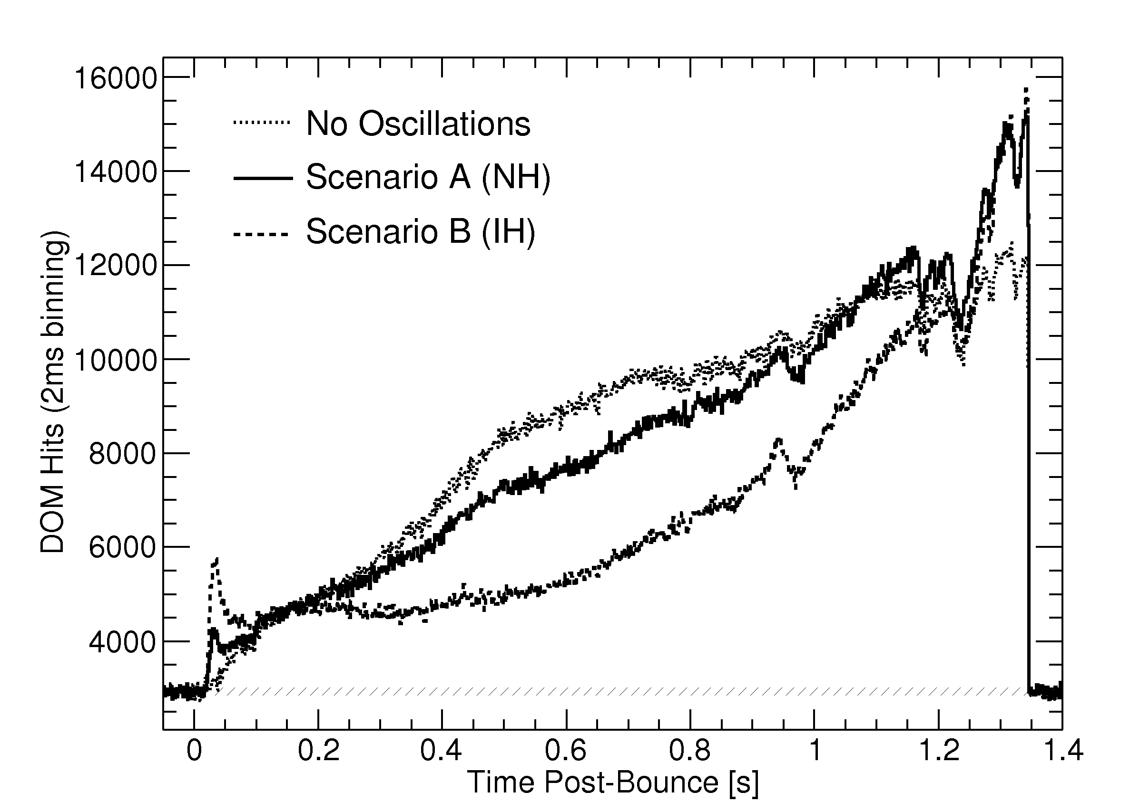
More exotic signals to hope for …
quark star formation black hole formation → no explosion!
>40 solar mass progenitor
normal
anti-υ peak!
inverted
Hierarchy
no oscillations
normal hierarchy
inverted hierarchy
Dasgupta et al., Phys. Rev. Lett. D 81,
103005 (2010)
Sumiyoshi et al.,
ApJ 667, 382 (2007)
black hole
formation

Slide 33
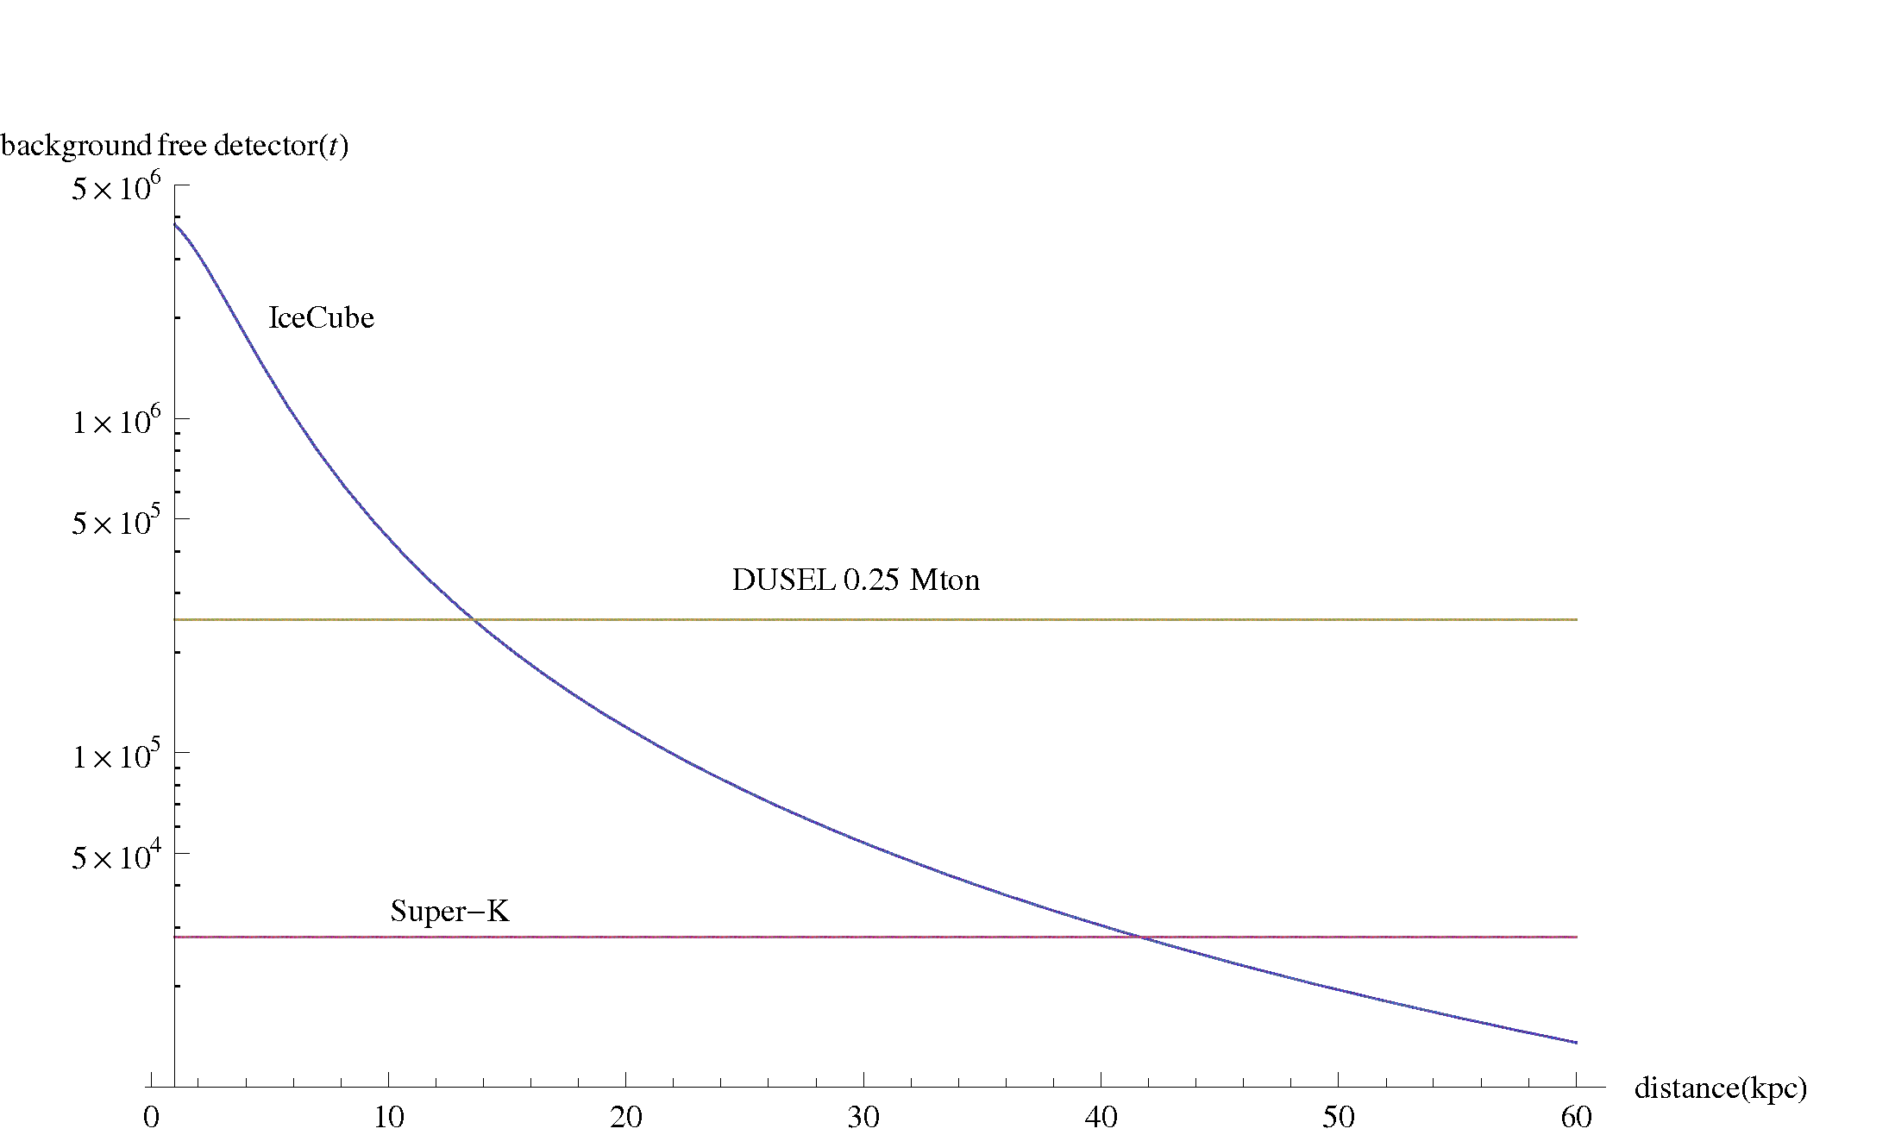
How does IceCube compare?
Due to noise background, the answer depends on the signal/noise assumption
→ … which is a function of distance, model and time within burst
equivalent mass background free detector (Mton)
example:
comparison of initial 0.38 s
Lawrence Livermore model!
IceCube
1 Mton
0.1 Mton
0.01 Mton
0.25 Mton
60% milky way
coverage
Super-K:
10% chance to see
SN in Andromeda
Super-K
distance [kpc]
0 10 20 30 40 50 60
take this plot with a big grain of salt !

Slide 34
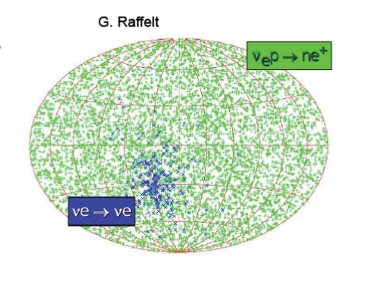
Super-K and IceCube make a good team ….
IceCube: Mton scale detector for close supernovae
study fine details of neutrino light curve
Super-K: energy, direction + some ν type separation
low background → handle for relic neutrinos
Talk M. Smy
Aim for combined analyses!!
discuss at workshop …
directional information 25º/√N

Slide 35
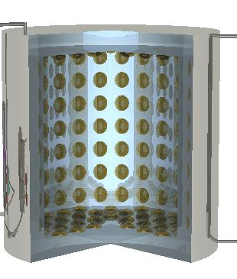
The future (Super-Kamiokande)
T2K 300 km base line experiment J-PARC→ Super-K; first interactions 2010!
Goal: test θ₁₃ down to 5x10⁻³ dependent on CP-phase δ; reach θ₁₃ ~ 4º by mid 2011
Add gadolinium to water for efficient antineutrino tagging → talk Michael Smy
Goal: Determine by mid-2012 if Gadolinium loading will be safe and effective
T2K θ₁₃ sensitivity
Gd loading test facility
Large n capture σ
Gd+n→G*→ Gd+γ
8 MeV total E_{γ}
4.0º
1.5º
July 2011 goal?
10²⁰ 10²¹ 10²²
200 ton tank 250 PMTs
Protons on target

Slide 36

One candidate for ν_{e} appearance!
Not significant …
29% probability for
background fluctuation
O0.5 GeV
0.3 background
events expected

Slide 37

Earth quake damage at J-PARC
Dump south
Earth quake, but no Tsunami damage; Super-Kamiokande is fine
Problems: Power, some outer structures

Slide 38


… the future (IceCube)
Find extra-terrestrial neutrinos!
Soon results from DeepCore extension with (10) GeV energy threshold:
→ bridge gap to Super-K to study
atmospheric ν oscillations, Wimps,
galactic sources
Think about even denser in-fill
with O(1) GeV threshold?
Dream about future ice – lab for
low energy ν physics and proton decay?
IceCube
Super-K
DeepCore
(IceCube veto)

Slide 39
Summary
SK-IV is running with the lowest energy threshold ever!
  100% efficiency at E_{total}~ 4.5MeV
  Full 3-flavor atmospheric and solar ν oscillation results
  More stringent proton decay limits
  R&D for Gadolinium in Super-K is underway (results 2012)
  Very efficient data taking for T2K beam
High sensitivity gradient for IceCube’s analyses
  Sensitivity has crossed Waxman-Bahcall bound
  Complementarity to direct dark matter searches
  Mton scale experiment for close supernovae
  One year of data from low energy extension DeepCore
  Ideas about future extensions being gathered

Slide 40

The Super-Kamiokande Collaboration
1 Kamioka Observatory, ICRR, Univ. of Tokyo, Japan
2 RCCN, ICRR, Univ. of Tokyo, Japan
3 IPMU, Univ. of Tokyo, Japan
4 Boston University, USA
5 Brookhaven National Laboratory, USA
6 University of California, Irvine, USA
7 California State University, Dominguez Hills, USA
8 Chonnam National University, Korea
9 Duke University, USA
10 Gifu University, Japan
11 University of Hawaii, USA
12 Kanagawa, University, Japan
13 KEK, Japan
14 Kobe University, Japan
15 Kyoto University, Japan
16 Miyagi University of Education, Japan
17 STE, Nagoya University, Japan
18 SUNY, Stony Brook, USA
19 Niigata University, Japan
20 Okayama University, Japan
21 Osaka University, Japan
22 Seoul National University, Korea
23 Shizuoka University, Japan
24 Shizuoka University of Welfare, Japan
25 Sungkyunkwan University, Korea
26 Tokai University, Japan
27 University of Tokyo, Japan
28 Tsinghua University, China
29 Warsaw University, Poland
30 University of Washington, USA
Autonomous University of Madrid, Spain (Nov.2008~)
~120 collaborators
31 institutions, 6 countries
From PRD81, 092004 (2010)

Slide 41

IceCube Collaboration
Sweden:
Stockholm Universitet
Uppsala Universitet
Germany:
RWTH Aachen
Universität Bochum
Universität Bonn
DESY-Zeuthen
Universität Dortmund
Humboldt Universität
MPI Heidelberg
Universität Mainz
Universität Wuppertal
USA:
University of Alaska, Anchorage
University of Alabama, Tuscaloosa
Bartol Research Institute, Delaware
University of California, Berkeley
Lawrence Berkeley National Lab.
Clark-Atlanta University
Georgia Tech
University of California, Irvine
Lawrence Berkeley National Laboratory
University of Maryland
Ohio State University
Pennsylvania State University
Southern University and A&M
College, Baton Rouge
University of Wisconsin-Madison
University of Wisconsin-River Falls
UK:
Oxford University
Switzerland:
EPFL
Belgium:
Université Libre de Bruxelles
Vrije Universiteit Brussel
Universiteit Gent
Université de Mons
Japan:
Chiba University
Barbados:
University of the West Indies
New Zealand:
University of Canterbury
36 institutions, ~250 members
http://icecube.wisc.edu
Notes:
PAS CITER TOUS LES PAYS MAUS JUSTE UW HALZEN

Slide 42

camera at 2450 m depth
Ice and freeze-in properties in itself interesting ….

Slide 43
General theoretical lessons on ν‘s
At least two neutrinos have (very small) masses
Masses are probably small, because ν‘s are of Majorana type (masses inverse proportional to large scale of lepton number violation)
Mass ~M_{R} empirically close to 10¹⁴-10¹⁵ GeV ~ M_{GUT}
Decays of right handed neutrinos produce baryogenesis via leptogenesis
0.025<(m²₂-m²₁)/(m²₃-m²₂)<0.039 @ 90CL
If m₁~0 (no degeneracy), m₃ >> m₂ (normal hierarchy): m₂/m₃~0.2 (close to λ_{c ~} 0.22 ?)
very small θ₁₃ and maximal θ₂₃ (45º) theoretically hard

Slide 44


Opera‘s nutau candidate
nu tau candidate opera

Slide 45


Search for p → e⁺ + π⁰ SK-I+II+III+IV
Preliminary
Signal MC
Data
no candidates!
SK-I-IV combined (205.7 kton/year):
τ_{proton} / B > 1.21 x10³⁴ yr
should reach 2 x 10⁻³⁴ by 2017 … if no candidates are found

Slide 46

Nucleon decay limits, status 2010
Proton is stable in the standard model …
GUT. SUSY models allow p decay, but predict different channels and lifetimes!
3x10³⁴
p→e⁺π⁰
Lifetime sensitivity
2x10³⁴
1x10³⁴
2010
2020
2030
limited by number of protons (SK: 7.5 x 10³³) and neutrons (SK: 6.0 x 10³³)
background and time !!

Slide 47

Comparison with an SO(10) Model
Phys Lett B587:105-116 (2004)
Super-K data are providing strong constraints to these models …
But need sensitivity ~ 1036 years to rule out minimal SUSY ???

Slide 48

Expected significance
preliminary
ξ
> 25 in Galaxy
~ 3-10 in
Magellanic clouds
depends on detection technique as well as model and neutrino properties …

